Slide 1
Electricity & Magnetism
Science 1.2
4 Credits, Internally Assessed

Slide 2
Topic Outline
Static Electricity
Positive, negative and neutral charges
Conductors and insulators
Charging and discharging objects
Current Electricity
Voltage, current and resistance
Parallel and series circuits
Ohm’s Law
Electrical power
Electrical safety
Magnetism
Magnetic field lines
Electromagnets

Slide 3
1. Static Electricity

Slide 4
Charge
Charges can be positive or negative
If an object has the same number of positive and negative charges, it is said to be electrically neutral
Opposite charges attract
Like charges repel
Activity: van der Graff generator

Slide 5
Conductors & Insulators
Conductors transport charges freely
Charges spread rapidly over the surface of a conductor
Insulators do not readily transport charge
Charges on an insulator tend to stay where they are put
Both conductors and insulators can store charge
Activity: Concept Map

Slide 6
Charging By Friction
When two objects rub past each other, charges can move from the surface of one object to the surface of the other

Slide 7
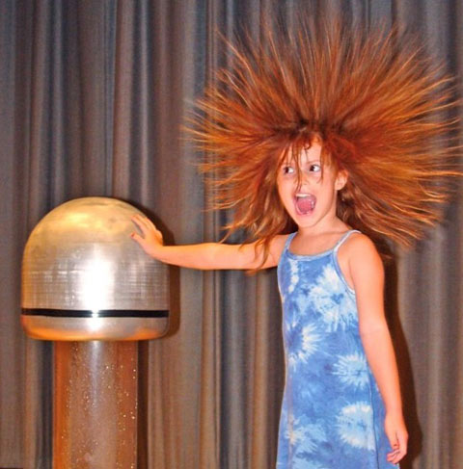
Charging By Contact
If a charged object comes in contact with another object, charges will be deposited on the surface of the second object

Slide 8
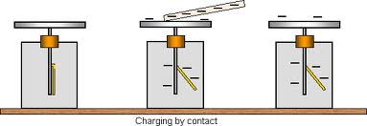
Charging an Electroscope by Contact

Slide 9
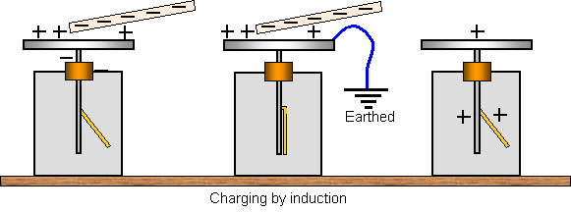
Charging an Electroscope by Induction

Slide 10
Electrical Discharge in Air
As particles in the air contact a charged object, some of the charges ‘leak’ off the object onto the particles
Will a van der Graff generator work better on a humid or a dry day? Explain your answer.

Slide 11
Electrical Discharge to Earth
If a conductor connects an object to the ground, any excess charges move off the object to the ground and the object is said to be ‘earthed’
The symbol for earthing an object is:

Slide 12
2. Current Electricity

Slide 13
Circuit Diagrams
A circuit has:
An energy supplier
An energy user
A conducting electrical pathway
Circuit diagrams:
Are based on the shape of rectangles
Are drawn using a ruler
Do not have gap
Activity: Complete Circuit Component Table

Slide 14
Current, Voltage, Resistance
Current is the number of charges going past a point every second
Voltage is how much energy each charge is carrying
Voltage is measured by comparing the energy per charge at two different points in a circuit
A resistor reduces the current through a circuit
Resistors convert electrical energy to heat (and sometimes light)

Slide 15
Ohm’s Law
Ohm’s Law gives the relationship between voltage across a resistor and the current through the resistor
V = IR
V = voltage, V
I = current, A
R = resistance, Ω
Worksheet: Ohm’s Law

Slide 16
Practical – Ohm’s Law
Aim: To determine the resistance of a bulb
Method:
Set up the circuit
Use the variable resistor to vary the current through the circuit
For each value of current, measure the voltage across the bulb
Repeat for 5 values of current

Slide 17
Practical – Ohm’s Law
Results
Draw a graph of voltage (y-axis) vs. current (x-axis)
Calculate the slope of your graph
Current (A) | Voltage (V) | Calculated Resistance (Ω)

Slide 18
Practical – Ohm’s Law
Conclusion
What was the gradient of your graph?
Compare these two equations:
V = RI
y = mx + c
What value does the gradient of the graph give you?
What was the resistance of your light bulb?

Slide 19
Resistors in Series
When resistors are in series, the total resistance is the sum of the individual resistances
R_{T} = R₁ + R₂ + ...
R_{T} = total resistance, Ω
R₁ = first resistor, Ω
R₂ = second resistor, Ω

Slide 20
Resistors in Parallel
When resistors are in parallel, the total resistance is found by adding the inverses of the individual resistances
R_{T} = total resistance, Ω
R₁ = first resistor, Ω
R₂ = second resistor, Ω
Worksheet: Ohm’s Law Part 2

Slide 21
Electrical Power
Power is a measure of how quickly energy is converted from one form to another
Power is measured in Watts (W)
Electrical power can be calculated by
P = VI
P = power, W
V = voltage, V
I = current, A
Worksheet: Power

Slide 22
Sci 1.2 Preparation A
Aim: To determine what happens to current as resistors are added in series.
Hypothesis: I think that as more resistors are added in series, the current will <increase/ decrease/stay the same>
Background Information:

Slide 23
Sci 1.2 Preparation A
Method:
Set up a series circuit with an ammeter and one resistor
Measure the current
Repeat for two and then three resistors in series
Results:
Conclusion:
Agree/disagree with your hypothesis
Use your background information to explain your results
Number of Resistors in Series | Current (A)
1
2
3

Slide 24
Sci 1.2 Preparation B
Aim: To determine what happens to temperature of water as the voltage across a heating element is increased
Hypothesis: I think that as the voltage is increased, the temperature of the water will <increase/ decrease/stay the same>
Background Information:

Slide 25
Sci 1.2 Preparation B
Method:
Set up the circuit
Measure the temperature every minute for 10 minutes
Share your results with the class
Results:
Time (min) | Temperature (℃ )
0
1
2
…
10

Slide 26
Sci 1.2 Preparation B
Class Results:
Conclusion:
Agree/disagree with your hypothesis
Use your background information to explain your results
Voltage (V) | Maximum Temperature (℃ ) | Change in Temperature (℃ )
2
4
6
8
10

Slide 27
Fuses and Circuit Breakers
Fuses and circuit breakers are safety devices
Fuses and circuit breakers break the circuit when current is too high

Slide 28
Sci 1.2 Preparation C
In NZ, mains power supply is 230 V
In USA, mains power supply is 120 V
Imagine you are writing safety advice for people moving to NZ from USA. Use your scientific knowledge to explain why it would be unsafe to use a toaster from USA in NZ.

Slide 29
3. Magnetism

Slide 30
Magnetic Fields
Magnets have north and a south pole
Magnetic field lines go from north to south
Field lines do not cross

Slide 31
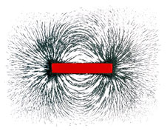
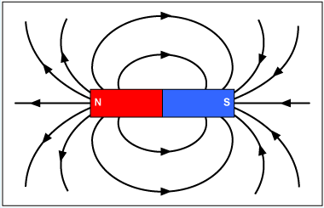
Magnetic Field Around a Bar Magnet

Slide 32
Magnetic Field Around A Current-Carrying Wire
When charges move through a wire, a magnetic field forms around the wire
We use the right-hand thumb rule to work out the direction of the magnetic field:
The thumb gives the direction of conventional current
The fingers give the direction of the magnetic field

Slide 33
Magnetic Field Around A Current-Carrying Wire

Slide 34
Magnetic Field Around A Current-Carrying Wire
We can calculate the strength of the magnetic field using the following equation:
B = magnetic field strength, Tesla, T
k = a constant, 2 x 10⁻⁷ N.A⁻¹
I = current, A
d = distance, m

Slide 35
Demonstration: AC generator
Demonstration: Current-carrying wire and large magnet
Worksheet: Magnetic field around a current-carrying wire

Slide 36
Magnetic Field Around A Solenoid
A solenoid is a coil of wire
When electrical current goes through the wire, the magnetic fields around each piece of wire add up and an electromagnet is formed
We use the right-hand thumb rule to work out the direction of the magnetic field:
The fingers give the direction of conventional current in the wires
The thumb gives the direction of the magnetic field

Slide 37
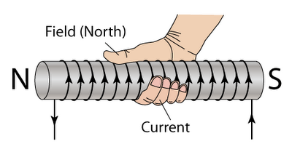
Magnetic Field Around A Solenoid

Slide 38
Electromagnets
Research an application of electromagnets:
What is the application you have chosen?
How is an electromagnet used in this application?
Use your scientific understanding of electromagnets to explain what happens in this use of electromagnets.

