Slide 1
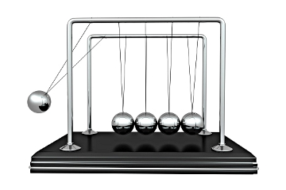
2.1 Practical Physics Investigation
4 Credits, Internal

Slide 2
Unit Outline
Measurement
Errors and Uncertainties
Graphing
Vectors and Scalars
Practice Internal
2.1 Internal Assessment

Slide 3
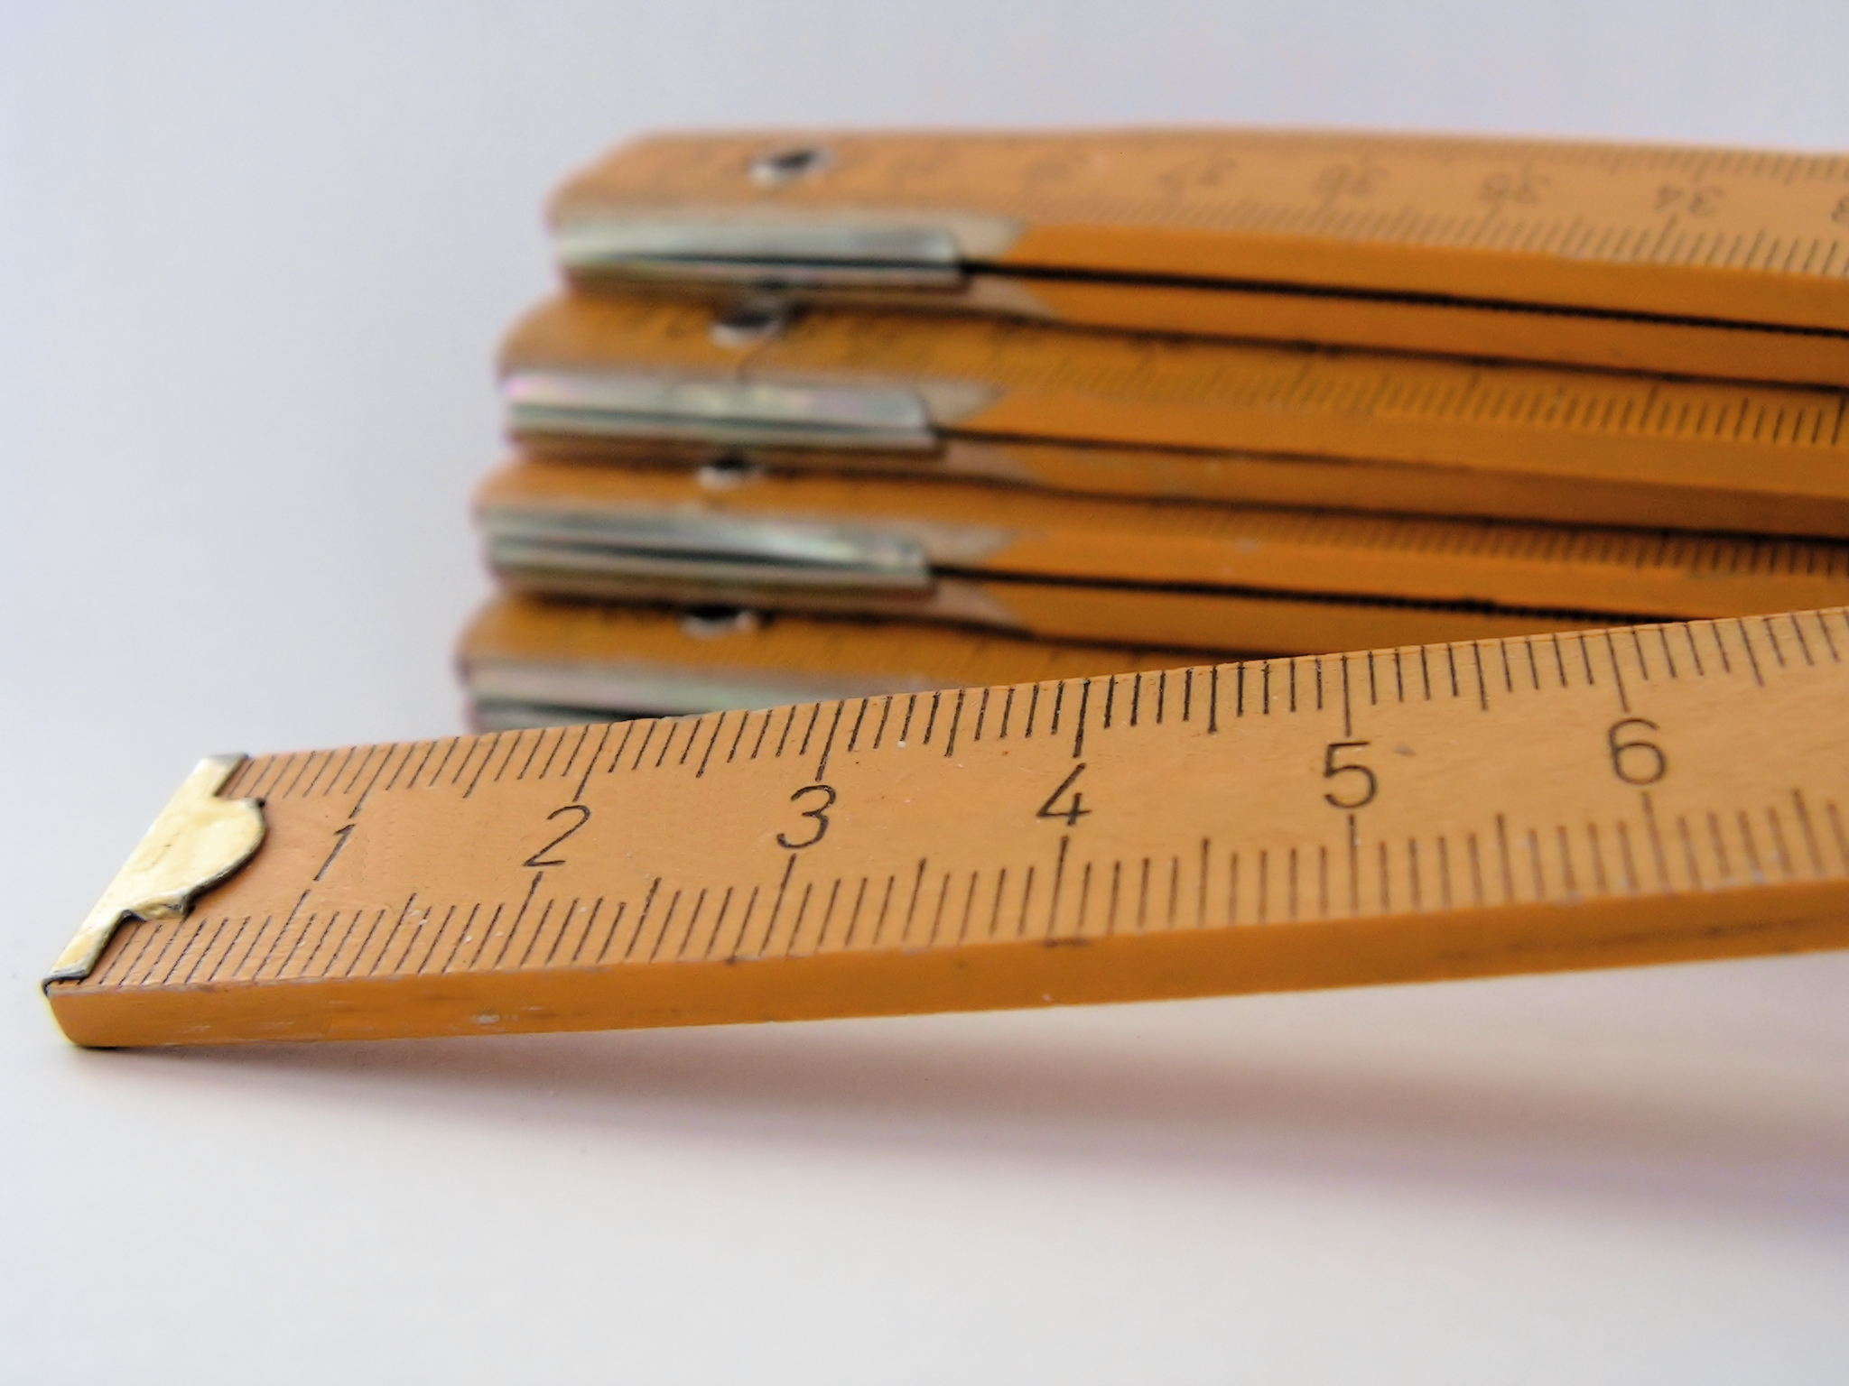
Measurement

Slide 4
Orders of Magnitude
Metric prefixes are used to express large or small numbers in a form that is more manageable
Prefix | Symbol | Order of Magnitude
tera | T | 10¹²
giga | G | 10⁹
mega | M | 10⁶
kilo | k | 10³
milli | m | 10⁻³
micro | μ | 10⁻⁶
nano | n | 10⁻⁹
pico | p | 10⁻¹²

Slide 5
Examples of Orders of Magnitude
Example | Order | Example | Order
Diameter of a sub-nuclear particle |  | Mass of a car
Diameter of an electron |  | Mass of Earth
Diameter of an atom |  | Mass of Sun
Height of a person |  | Mass of Universe
Diameter of Earth |  | Time for light to travel across nucleus
Diameter of Sun |  | Time for light to travel from Sun to Earth
Distance light travels in a year |  | Time for light to travel from Sun to Pluto
Diameter of visible Universe |  | Average human life span
Mass of an electron |  | Time for light to travel from Alpha Centuri to Earth
Mass of an atom |  | Age of Universe

Slide 6
Examples of Orders of Magnitude
Example | Order | Example | Order
Diameter of a sub-nuclear particle | 10⁻¹⁵ m | Mass of a car | 10³ kg
Diameter of an electron | 10⁻¹³ m | Mass of Earth | 10²⁵ kg
Diameter of an atom | 10⁻¹⁰ m | Mass of Sun | 10³⁰ kg
Height of a person | 10⁰ m | Mass of Universe | 10⁵⁰ kg
Diameter of Earth | 10⁷ m | Time for light to travel across nucleus | 10⁻²³ s
Diameter of Sun | 10⁹ m | Time for light to travel from Sun to Earth | 10² s
Distance light travels in a year | 10¹⁶ m | Time for light to travel from Sun to Pluto | 10⁴ s
Diameter of visible Universe | 10²⁵ m | Average human life span | 10⁹ s
Mass of an electron | 10⁻³⁰ kg | Time for light to travel from Alpha Centuri to Earth | 10⁸ s
Mass of an atom | 10^{-27 kg} | Age of Universe | 10¹⁸ s

Slide 7
Standard Form
In standard form, we write one digit before the decimal place and then the appropriate order of magnitude
476 293 000 = 4.76293 x 10⁸
0.000000516 = 5.16 x 10⁻⁷
Orders of magnitude can be used to estimate or compare measurements

Slide 8
Significant Figures
Significant figures are digits that are not merely placeholders
Number | Number of Significant Figures
4
400
0.000000004
4.0
127 000
0.02365
0.0236500
500 000.00007

Slide 9
Significant Figures
Significant figures are digits that are not merely placeholders
Worksheet 1: Significant Figures and Standard Form
Number | Number of Significant Figures
4 | 1
400 | 1
0.000000004 | 1
4.0 | 2
127 000 | 3
0.02365 | 4
0.0236500 | 6
500 000.00007 | 11

Slide 10
Rounding
Calculations are rounded to the same number of significant figures as the least accurate value in the calculation
2.430923485498 + 3.1 = 5.5 (2 s.f.)

Slide 11
SI Base Units
Physicists have an agreed system of units, called ‘Le Système International d’Unités’ (S.I. Units)
There are seven base units, all other units are derived from these
Quantity | Quantity Symbol | Unit | Unit Symbol
Length | l | metre | m
Mass | m | kilogram | kg
Time | t | second | s
Electric current | I | ampere | A
Temperature | T | Kelvin | K
Amount of substance | n | mole | mol
Luminous intensity | l_{v} | candela | cd

Slide 12
Derived Units
Derived units are formed from a combination of SI base units
To derive a unit for a variable, we use the equation for that variable
F = m x a
So the units for force are kg x ms⁻² = kgms⁻² = N

Slide 13
Errors
Errors are sources of uncertainty in a measurement
There are two main classes of error:
Systematic errors are the result of the equipment or method (system), e.g. zero error, poorly calibrated instruments
Random errors occur randomly and are reduced by repeating measurements, e.g. normal variations, parallax error, insensitive instruments

Slide 14
Uncertainties
The uncertainty is an estimate of the possible inaccuracy in a measurement
We estimate the uncertainty in a measurement to be half the ‘limit of reading’, i.e. half the smallest scale division
If there is possibility for error at either end of the measurement, the uncertainty is the smallest scale division
If repeated measurements are made, the uncertainty is half the range of the measurements
Uncertainties are given to 1 s.f. only

Slide 15
Practical
Observe zero error with a force meter
Observe parallax with an analogue meter
Time one oscillation of a pendulum then compare with measuring 10 oscillations and dividing by 10
Use Vernier calipers to measure the thickness of a piece of paper
Use Vernier calipers to measure the diameter of a marble, make 5 measurements to give a value and an uncertainty

Slide 16
Vernier Scales

Slide 17
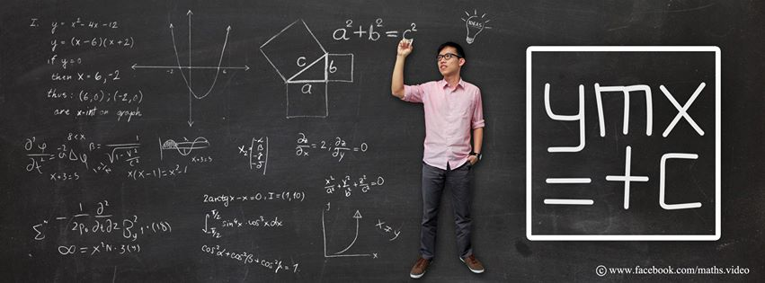
Graphing

Slide 18
Graphing Skills
When drawing a graph:
Use pencil, ruler and graph paper
Use suitable sized axes
Mark values with a linear scale
Label the axes, including units
Give a descriptive title
Plot data points
Draw a best-fit trend line

Slide 19
Graphing Skills
To find the gradient:
Find two places where the best-fit line passes through easy-to-read points on the graph
Calculate the rise (Δy)
Calculate the run (Δx)
Calculate the gradient (Δy/Δx)

Slide 20
Linear: y α x
If the y-intercept is zero, we can also say that y is directly proportional to x

Slide 21
Squared: y α x²
Plotting distance vs. time² will give a straight line graph of the form y = mx + c

Slide 22
Squared: y α x²
d = 5t² + 0
y = mx + c

Slide 23
Square Root: y α √x
Plotting time vs. √distance will give a straight line graph of the form y = mx + c

Slide 24
Inversely Proportional: y α 1/x
Plotting volume vs. 1/pressure will give a straight line graph of the form y = mx + c

Slide 25
Inverse Square: y α 1/x²
Plotting intensity vs. 1/distance² will give a straight line graph of the form y = mx + c

Slide 26
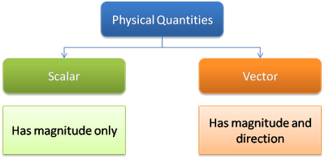
Vectors & Scalars

Slide 27
Vectors and Scalars
Scalar quantities only have magnitude (size)
e.g. distance, speed, mass, time,, charge, energy
Scalars are added algebraically
Vector quantities have magnitude and direction
e.g. displacement, velocity, force, momentum
Vectors are added in a particular way

Slide 28
Vector Addition
Vectors are added ‘head to tail’ to find the resultant vector
For example, adding vectors a and b
If this forms a right-angled triangle, use Pythagoras’ Theorum to find the length of the resultant, and trigonometry to find the angle
a
a
b
b
a + b

Slide 29
Vector Subtraction
To subtract one vector from another, switch the direction of the arrow of the vector that is to be subtracted, then add the vectors
For example, a - b
-b
a
b
-b
a - b
a

Slide 30
X and Y Components of a Vector
A vector can be resolved into its horizontal and vertical components
We use trigonometry to find the lengths of the x- and y-components

Slide 31
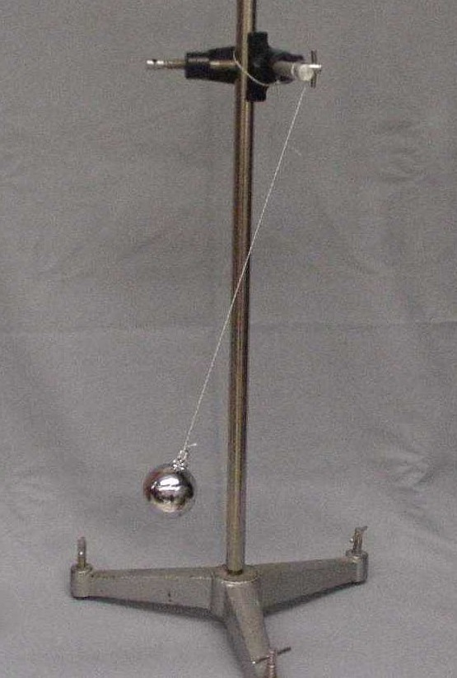
Practice Internal

Slide 32
Simple Pendulum - Aim
To find the relationship between length and period of a simple pendulum

Slide 33
Simple Pendulum - Method
Set up a simple pendulum
Vary the length and measure the time period
Use five values of the independent variable
Use repeated measures (10 swings then divide by 10) for each measurement of period
Make five measurements of period for each length
Plot a graph

Slide 34
Simple Pendulum - Results
Length (m) ± 0.001 m | Time for 10 Swings (s) | Time for 1 Swing (s) | Uncertainty in Period (s)
 | <5 measurements> | <average> | <half range>

Slide 35
Simple Pendulum – Data Analysis
Plot a graph of period (y-axis) vs. length (x-axis)
Draw a curve of best fit
Determine the type of relationship
Process your data by processing the variable on the x-axis
Plot a second graph
Use y = mx + c to make an equation for your data

Slide 36
Simple Pendulum - Conclusion
State the mathematical relationship between your variables

Slide 37
Simple Pendulum – Discussion
Explain why your results are valid
How your results fit with physics theory
The variables you controlled, how you controlled them, and why they needed to be controlled
The accuracy improving techniques you used, what you did and why it needed to be done
The reason for the limits of the range of your independent variable
Any difficulties and how they were over come

Slide 38
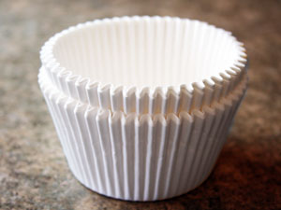
Terminal Velocity - Practice

